Slide 1

Gaussian Mixtures
DEEP LEARNING 1
Presenter :- Abdullah Zafar

Slide 2
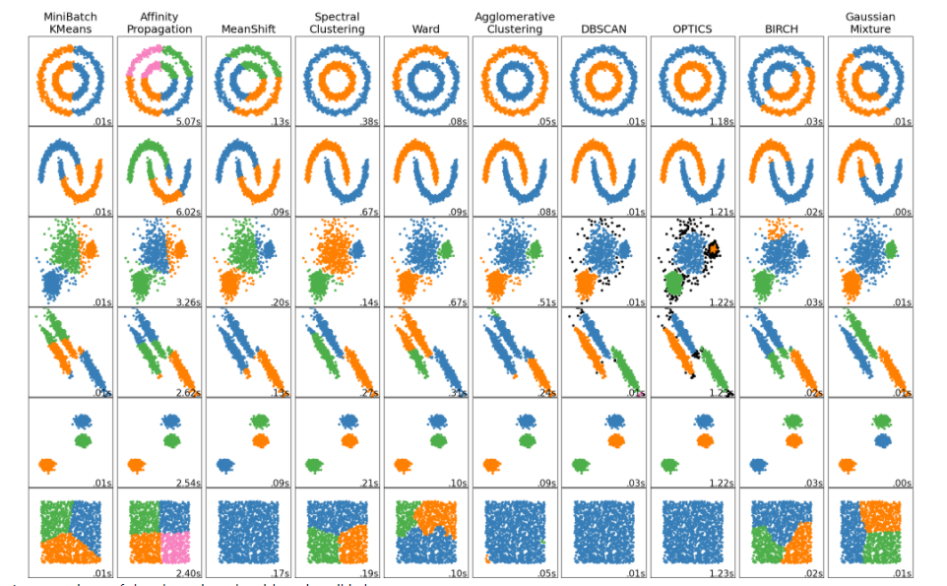
What is Clustering?

Slide 3
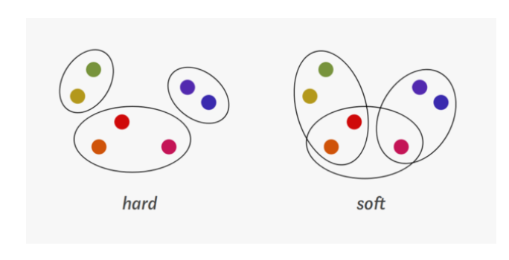
HARD CLUSTERING VS SOFT CLUSTERING

Slide 4
What are Gaussian Mixtures?
A Gaussian mixture model is a probabilistic model that assumes all the given data points are regenerated from a mixture of a finite number of Gaussian distributions with unknown parameters and tends to group the given points to a single distribution that it belongs to.

Slide 5
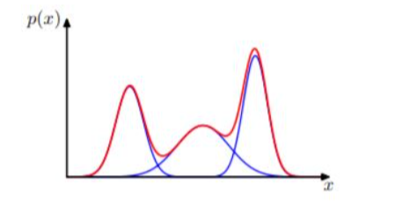

Gaussian Mixture Model
Gaussian mixture distribution with three Gaussians represented in red and their sum in Blue
GAUSSIAN MIXTURE MODEL

Slide 6
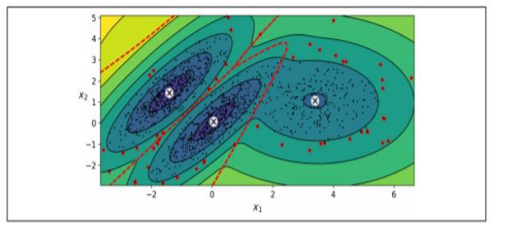
ANOMALY DETECTION USING GAUSSIAN MIXTURE MODELS
any instance being located in a low density region can be referred as an anomaly.
Anomalies are represented as stars
Can be used for:
detecting fraud
detecting defective products

Slide 7

BAYESIAN GAUSSIAN MIXTURE MODELS
Selecting the right number of clusters!
Unnecessary clusters given a weight of zero or closer to zero.

Slide 8

ESTIMATION ALGORITHM : EXPECTATION-MAXIMIZATION
E STEP
calculation of the expectation of the component assignments for each data point given the model parameter such as φ μ and σ
M STEP
updating the values of φ μ and σ that were initially calculated. Hence, following an iterative method to reach closer to the correct solution.

Slide 9
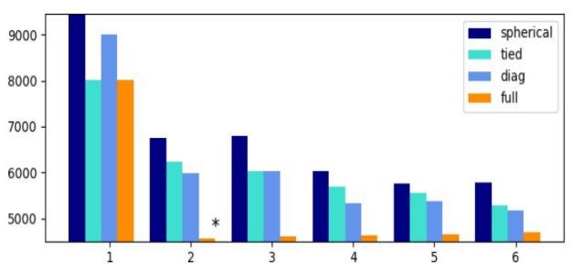
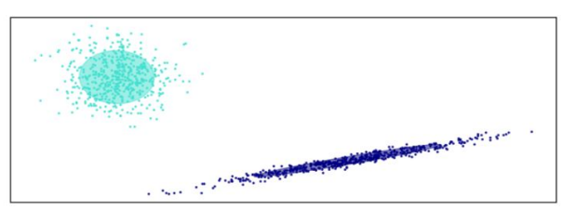
GAUSSIAN MIXTURE MODEL SELECTION(Example)
BIC score per model
Selected GMM:full model, 2 components

Slide 10
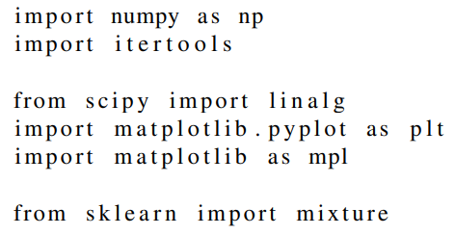
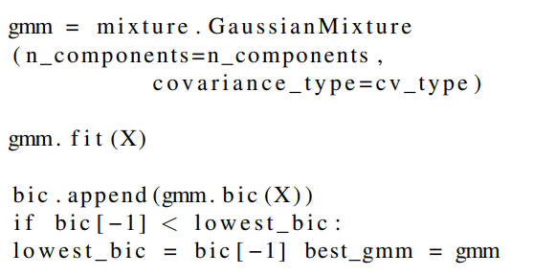
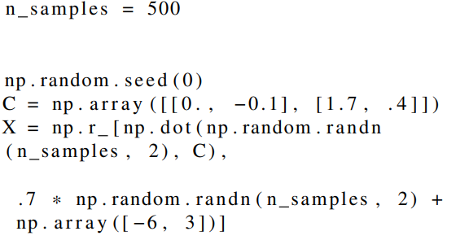
Important Code section walkthrough
Extracted from scikit

Slide 11
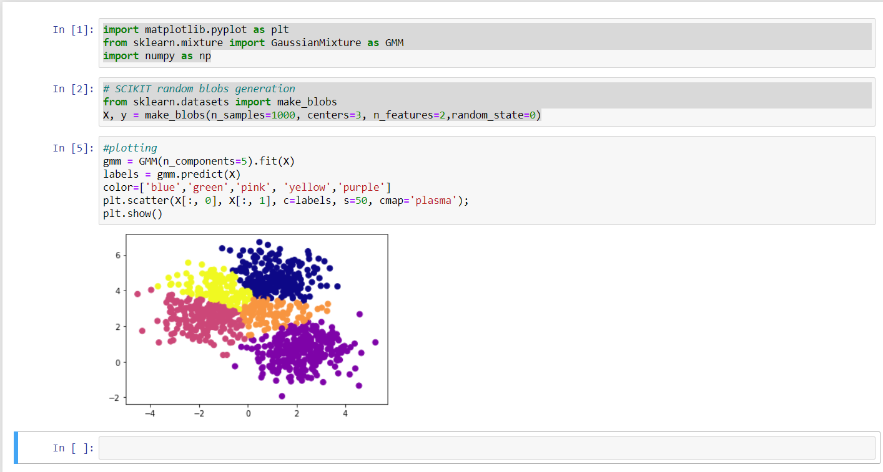

Slide 12

Draw Backs of Gaussian Mixtures
Gaussian mixtures have a few drawbacks associated to it. Estimating the covariance matrices becomes difficult in case there is an insufficient number of points present per mixture.

Slide 13

APPLICATIONS OF GAUSSIAN MIXTURE MODELS
Fuzzy image segmentation
Handwriting recognition
Data stream clustering
defect detection in products
Modeling weather observations in Geo-science
Speech recognition

Slide 14
Summary
Clustering is a unsupervised method where clusters area is made around the data set that share the same characteristics.
A Gaussian mixture model is a probabilistic model that assumes all the given data points are generated from a mixture of a finite number of Gaussian distributions with unknown parameters and tends to group the given points to a single distribution that it belongs to.
Anomaly Detection is the process of locating the instances that oppose the convention in a very strong manner.
Bayesian Gaussian mixture helps in determining the correct number of clusters.

Slide 15
Summary
Expectation-Maximization is a well developed statistical algorithm that allows us to estimate the parameters of the mixture model.
Gaussian Mixtures enable us to perform soft clustering unlike K-Means.

Slide 16
Thankyou! I am more than happy to answer any questions

Slide 17
Sources
https://pixabay.com/illustrations/telephone-screen-neuron-brain-6352038/
https://scikit-learn.org/stable/modules/clustering.html (Slide 2)
https://pixabay.com/illustrations/artificial-neural-network-ann-3501528/
https://pixabay.com/vectors/circuits-brain-network-chip-5076887/
https://pixabay.com/illustrations/artificial-intelligence-4458326/
https://pixabay.com/illustrations/mindset-programmer-machine-learning-3536805/
https://towardsdatascience.com/a-friendly-introduction-to-text-clustering-fa996bcefd04

